Slide 1


Mentoring as a value in the emotional education of students
Phd. Manuel Pestano
Phd. Celia Fernández
Dh. Haridian Rodríguez

Slide 2


Maximising learning through digital mentoring and emotional intelligence.

Slide 3

Why tutoring?

Slide 4

Why digitalise?

Slide 5

To understand each other…
Is digitising part of tutoring?
Mentoring is not understood if it is not digitised?

Slide 6
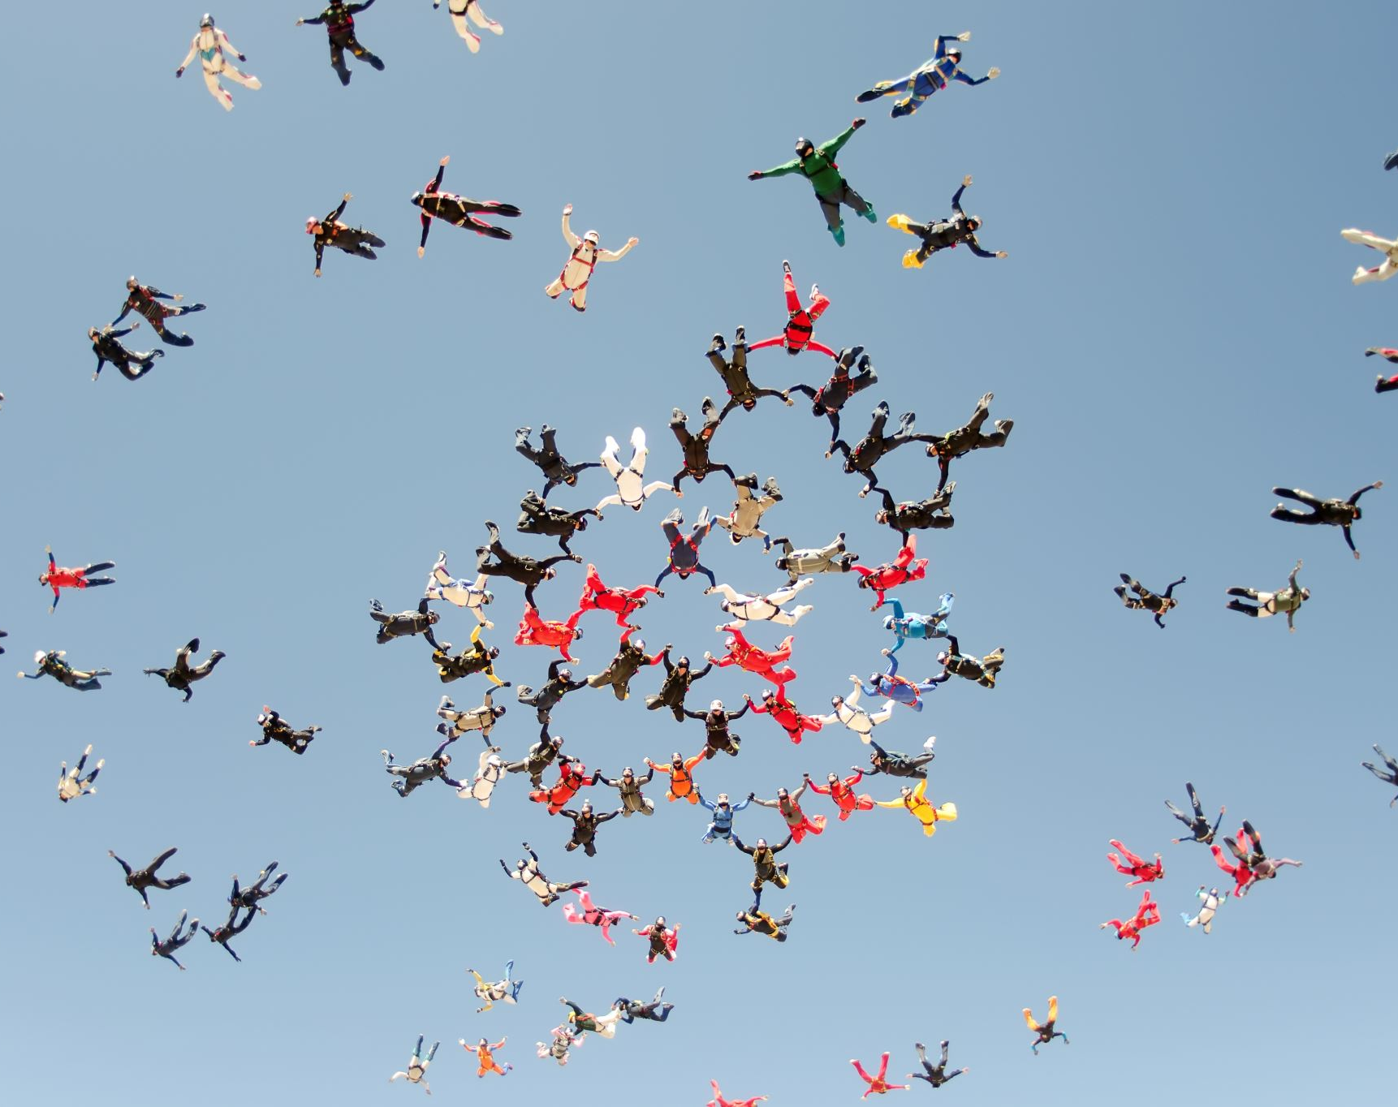
What about emotional education?
Is it necessary to tutor from emotions?
Is emotion necessary for digital skills and abilities?

Slide 7
2021
2021-2022
Estudio
empírico
Fase II
2022-2024
DGOIPE Meeting
Fase I
Relevant aspects and subject of the problem
Fase III
Joint training
and ongoing
Presentation of the e-Mentor
Documentation
Results
Resolutions
Collegial supervision
Programme Analysis
Quantitative and Qualitative
Problem Statement
Coordination and
teamwork
Origin
Need
Social bonding
Importance
Methodological update
Problems
Project initiative
Support measures in CCBB
Inter-stage coordination
Literature
Population
Outreach
Model
Research assumptions
research
By type of instrument
By objectives
Project planning
Objectives
Project implementation
Project closure 2024
Fase IV
DISCUSION
CONCLUSION
Notes:
Atendiendo a la temporalización de la tesis, comenzó en el curso 2012-2013 con las reuniones preparatorias del proyecto de tesis.
En el curso 2013-2014 se concretó el modelo y fundamentación teórica comprendido en dos fases realizadas, así como el desarrollo metodológico de la investigación.
Y en el curso 2014-2015 finalizamos resultados, así como discusión y conclusiones, procediendo en el 2016 a la presentación y defensa de esta tesis doctoral.

Slide 8

Integrating mentoring into a value-added mentoring ecosystem and differentiators
Ensure that education systems provide all the means and resources for the development of competences, preparing them for adult life.
Ensure that competences function well and are adapted to the needs of learners who require them.
Ensuring the updating of skills and abilities, with a view to lifelong learning.
Establish infrastructures that are adapted to the continuing education and training of individuals, ensuring assessment systems, promoting equality, and meeting needs.
Providing coherence between supply and demand in education and training by consolidating policies oriented towards quality in employment.

Slide 9
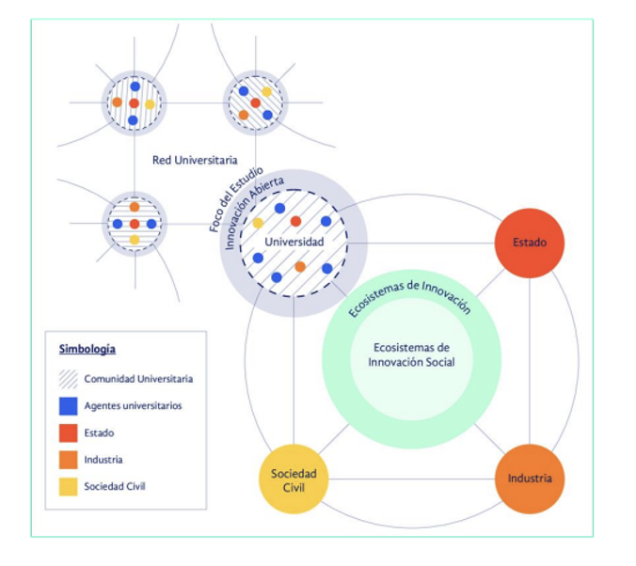
Integrating mentoring into a value-added mentoring ecosystem and differentiators

Slide 10
And the role of emotional intelligence/education
Digital tutoring provides a safe space for students to explore and understand their emotions. Through guided activities and reflections, they develop the ability to recognise and understand their own emotions and those of others.
Digital tutors teach effective strategies for regulating emotions, helping students to manage stress, anxiety and other negative emotions. This enables them to maintain a healthy emotional balance and improve their overall well-being.
Digital tutoring fosters empathy and the development of social skills. Students learn to put themselves in the shoes of others, to understand and respect different perspectives, and to establish healthy and meaningful relationships with their peers and tutors.

Slide 11
Enhancement of the most appropriate methodological approaches for the development of mentoring and emotional education (homeostasis).
Creation of environments and contexts
Integration and motivation
Coordination and projection

Slide 12
Qué herramientas se plantean
E-learning platforms
Videoconferencing tools
Emotional intelligence applications
Monitoring and evaluation software

Slide 13
Depending on the degree of innovation, mentoring becomes an ethical challenge in education.
Degrees of mentoring through emotional education
RADICAL
DISRUPTIVA
INCREMENTAL

Slide 14

Digital mentoring gives way to innovation, and innovation gives way to proactivity in new times.
Idea generation
Idea selection
Concept development
Living prototype design
Project Launch
Learning evaluation
Continuous improvement

Slide 15
Benefits to be studied of linking emotional education with new teaching parameters
Contextual Sensitivity
Linked to criterion Training Programme and Organisation of Teaching (Leadership and Planning and Strategy)
Creativity
Linked to criterion Human and Material Resources
Conceptual Knowledge
Linked to the criterion Formative Programme and Formative Process (Leadership, Processes and Strategy)
Coherence
Linked to the criterion Training Programme, Teaching Organisation
Critical Reflection
Linked to the criterion Formative Process, Human Resources and Outcomes
Notes:
Por ello hemos relacionado los Principios que mencionan Yanchar y Williams (a la izquierda), con los criterios del EFQM (a la derecha en negro) y, como pueden comprobar, con las dimensiones que hemos utilizado en nuestra investigación (a la derecha en rojo)

Slide 16
BIBLIOGRAPHY
607 REFERENCES USED
(Articles, books and electronic resources)
Notes:
He utilizado 607 referencias bibliográficas y presento en el CD 20 anexos.

Slide 17

THANKS!!

